Slide 1

Duality AI's Space Station Challenge: Safety Object Detection
Team name : Cryptocoders
Team Leader : V Sai Teja
Team Members: M Deepthi, J Aakash, G Revanth, A Rushitha, M Sreeja

Slide 2
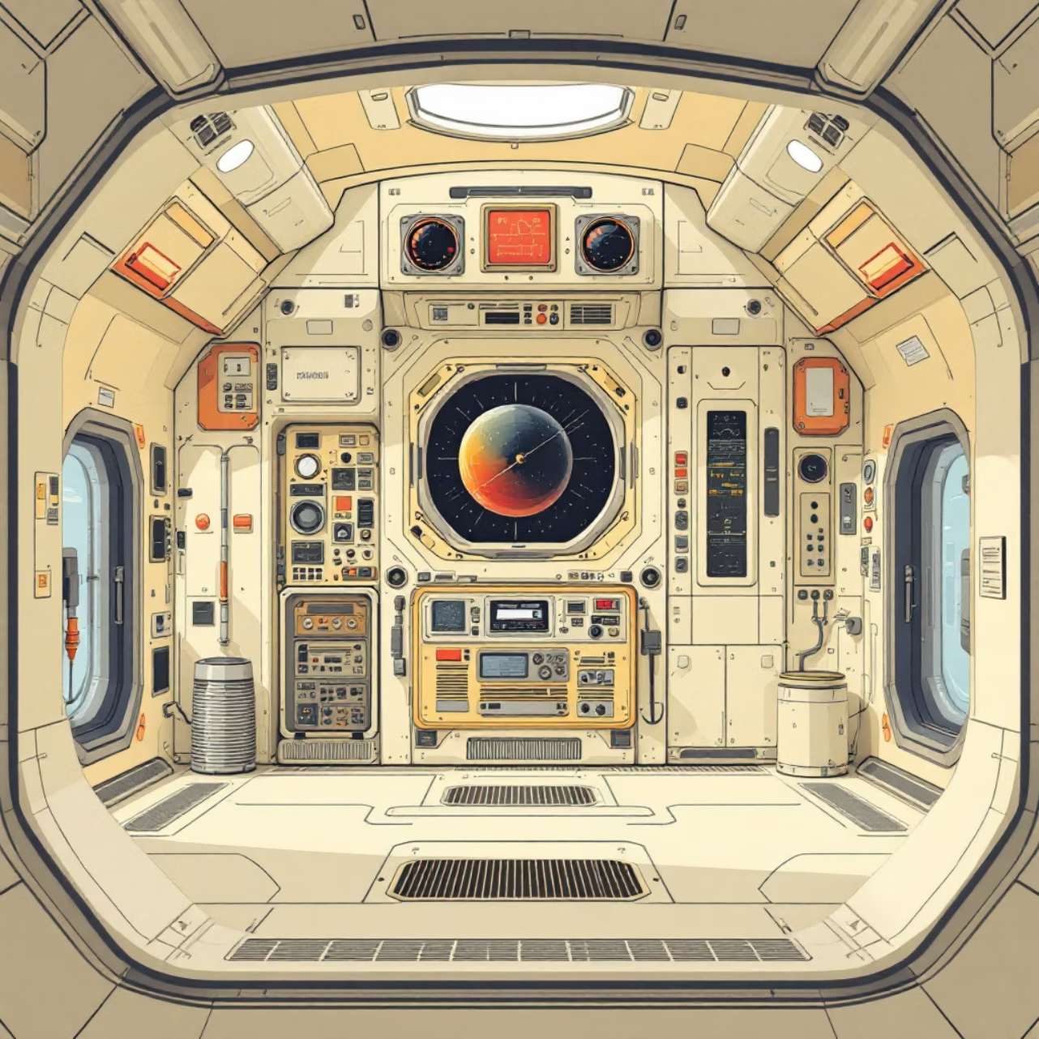
Problem Statement
Space stations operate in extreme environments where safety is paramount. Traditional monitoring systems fall short in detecting critical safety objects in real-time.
Our challenge: Develop an AI-powered object detection system that can accurately identify and classify safety-related objects within space station environments.
This system must handle complex scenarios, varying lighting conditions, and maintain high accuracy to prevent potential hazards.

Slide 3
Core Objectives
Real-Time Safety Monitoring
Multi-Class Detection Accuracy
Autonomous Risk Assessment
Continuous surveillance of critical safety equipment and potential hazards throughout the space station
Precise identification of diverse safety objects including emergency equipment, protective gear, and potential threats
Intelligent analysis of detected objects to assess safety compliance and identify potential risks automatically

Slide 4
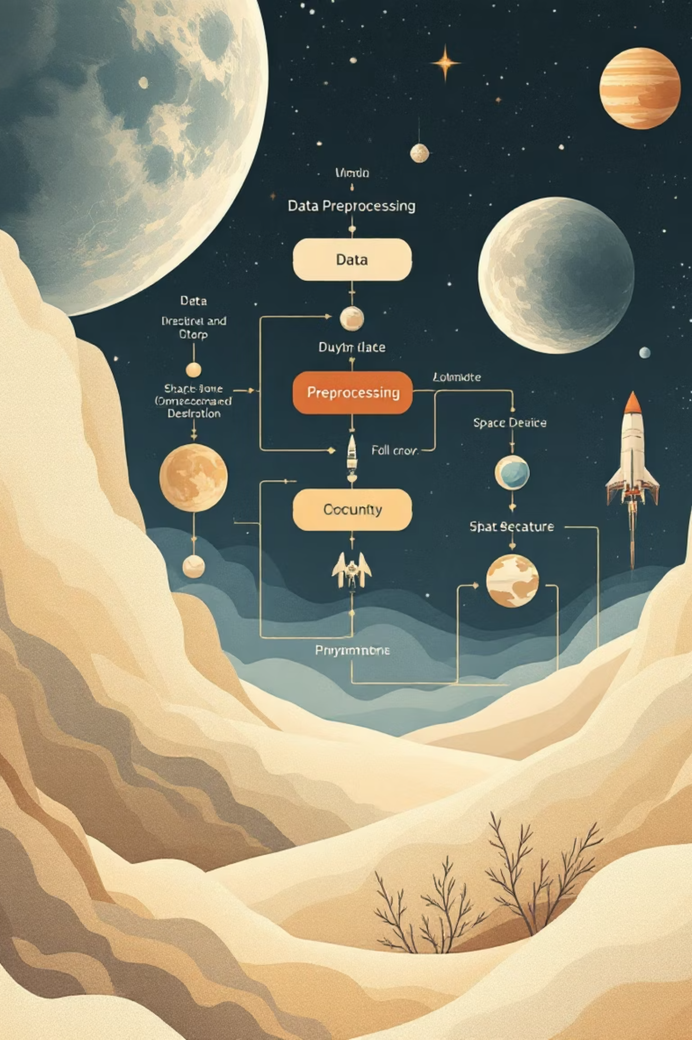
Dataset & Preprocessing Pipeline
01
Duality AI Dataset Integration
Comprehensive collection of annotated space station imagery with diverse safety object classes
02
Image Preprocessing
Resizing to optimal dimensions, noise reduction, and contrast enhancement for improved detection
03
Data Augmentation
Rotation, scaling, and lighting variations to increase dataset robustness and model generalisation
04
Normalisation & Validation
Pixel value normalisation and dataset splitting for training, validation, and testing phases

Slide 5

Model Architecture & Design
Selected Architecture: YOLOv8
State-of-the-art real-time object detection
Optimised for multi-class detection scenarios
Enhanced backbone network for improved accuracy
Efficient anchor-free detection head
Key Hyperparameters
Learning rate: 0.001 with cosine annealing
Batch size: 16 for optimal GPU utilisation
Input resolution: 640×640 pixels
Training epochs: 150 with early stopping

Slide 6




Implementation Workflow
Data Preparation
Preprocessing
Dataset loading, annotation parsing, and quality validation
Image enhancement, augmentation, and batch preparation
Model Training
Evaluation
Network optimisation, loss minimisation, and weight adjustment
Performance metrics calculation and result analysis

Slide 7
Project Roadmap: Space Station Safety Object Detection
Environment Setup
Data Collection & Annotation
Install necessary libraries, frameworks, and configure development tools for a robust MLOps pipeline.
Gather relevant satellite imagery and meticulously label objects (e.g., debris, tools, astronauts) for training.
Data Preprocessing
Model Selection & Configuration
Clean, normalize, and augment the annotated dataset to enhance model robustness and generalization.
Choose an appropriate object detection architecture (e.g., YOLO, Faster R-CNN) and fine-tune its hyperparameters.
Training Pipeline Setup
Model Training
Automate the training workflow, including data loading, model initialization, and checkpointing mechanisms.
Train the selected model on the preprocessed dataset, monitoring loss and performance metrics.
Validation & Testing
Performance Optimization
Rigorously evaluate model performance on unseen validation and test sets using metrics like mAP and F1-score.
Refine model architecture, apply quantization, or explore knowledge distillation to improve inference speed and efficiency.
Deployment Preparation
System Integration
Package the optimized model and its dependencies into a deployable format, suitable for the target environment.
Integrate the object detection module into the existing space station safety monitoring system.
Testing & Validation (Integrated)
Production Deployment
Conduct comprehensive end-to-end testing of the integrated system to ensure functionality and reliability.
Release the system to the operational environment, initiating real-time object detection for safety monitoring.

Slide 8
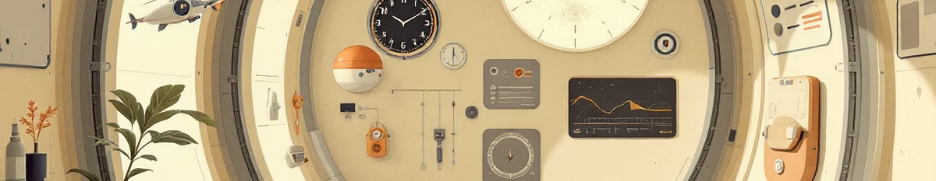
Results & Performance Metrics
94.2%
91.8%
89.6%
0.87
Overall Accuracy
Precision Score
Recall Rate
mAP Score
High precision across all safety object classes
Minimised false positive detections
Effective identification of critical objects
Strong multi-class detection performance

Slide 9
Challenges Encountered
Class Imbalance Issues
False Positive Detections
Training Complexity
Uneven distribution of safety object types in training data, leading to biased model predictions towards common classes
Model occasionally misidentifying non-safety objects as critical equipment due to similar visual features
High computational requirements and extended training times for achieving optimal model convergence

Slide 10

Solutions & Optimisations
1
Advanced Data Augmentation
2
Hyperparameter Tuning
Implemented sophisticated augmentation techniques including mixup and mosaic to balance class distribution
Systematic optimisation of learning rates, anchor boxes, and loss function weights for improved performance
3
Robust Evaluation Framework
Multi-metric validation including confusion matrices and precision-recall curves for comprehensive assessment

Slide 11
Future Scope & Conclusion
Edge Device Deployment
Enhanced AI Integration
Optimise model for deployment on space station edge computing devices with limited resources
Incorporate predictive analytics and automated response systems for proactive safety management
1
2
3
Multi-Domain Applications
Extend system capabilities to aviation safety, healthcare monitoring, and industrial manufacturing

